Slide 1


only [24]
made this week
Notes:
Slide 1. Hook. Swap in a photo of the whole batch. Type your real number.

Slide 2

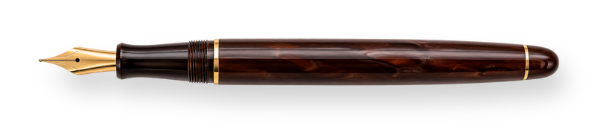
[not a factory]
No. [07] of [24]
[a small batch]
Notes:
Slide 2. Second hook: Instagram often shows a carousel starting on slide 2, so this one works as a cover on its own. No photo needed. Type your real numbers on the card and edit both [bracket] lines.

Slide 3


No. [07] of [24]
small
batch
Notes:
Slide 3. Swap in a photo of one being picked up. Type its number on the card.

Slide 4


each one
numbered
[each one signed by hand]
Notes:
Slide 4. Swap in a photo of the batch for the card window. Edit the line.

Slide 5

small
batch
Notes:
Slide 5. The batch, close: a full-page photo.

Slide 6

next batch
[Oct 30]
Notes:
Slide 6. Type your real next batch date and move the circle onto it.

Slide 7


[yours ships Friday]
Notes:
Slide 7. Swap in a photo of one being packed. Edit the line.

Slide 8


Comment
"[KEYWORD]"
[Product name]
Notes:
Slide 8. Swap in a photo of your product. Type its name and your keyword. Caption to start from (CTA in the first two sentences, 3 hashtags): Comment [KEYWORD] and I will send you [the link]. [One line of real context: who it helps or how you use it.] #[tag] #[tag] #[tag]

